Slide 1
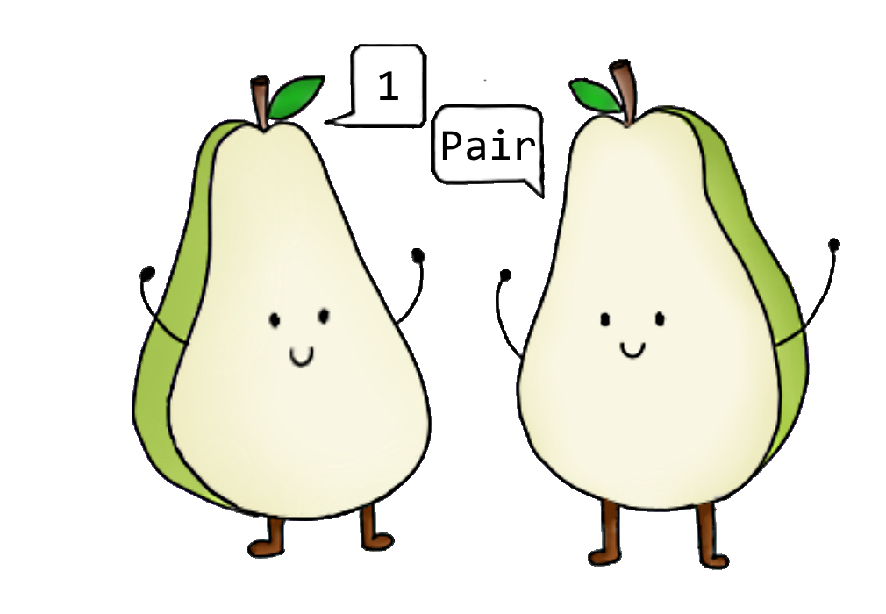
ifandonlyif
1Pair
CZ2006 Software Engineering Lab SS6
Chua Kok Liang, Grace Mok Jie Qi, Jozua Heng Yi Jie, Nicholas Yeo Ming Jie, Royce Ang Jia Jie & Shahrin Chua Zong Da

Slide 2
Problem
Sometimes we find one-for-one deals that we want, but have no one to pair up with

Slide 3
Objective
Allow users to see available one-for-one deals
Find another user to match with based on preferred location and deal
Chatroom to make appropriate arrangements available once match occurs

Slide 4
APIs Used
RESTful API
Picasso API
API to get scrapped data for deals
API to display images from image url
Firebase API
Government Train Station API
API to store user data, session token & chat data
API to retrieve locations with MRT Stations
ArthurHub’s Android Image Cropper
API to allow users to upload profile picture
Notes:
https://data.gov.sg/dataset/c89bb614-b4ac-4669-8c65-a2e2ea5211a6 (train)

Slide 5
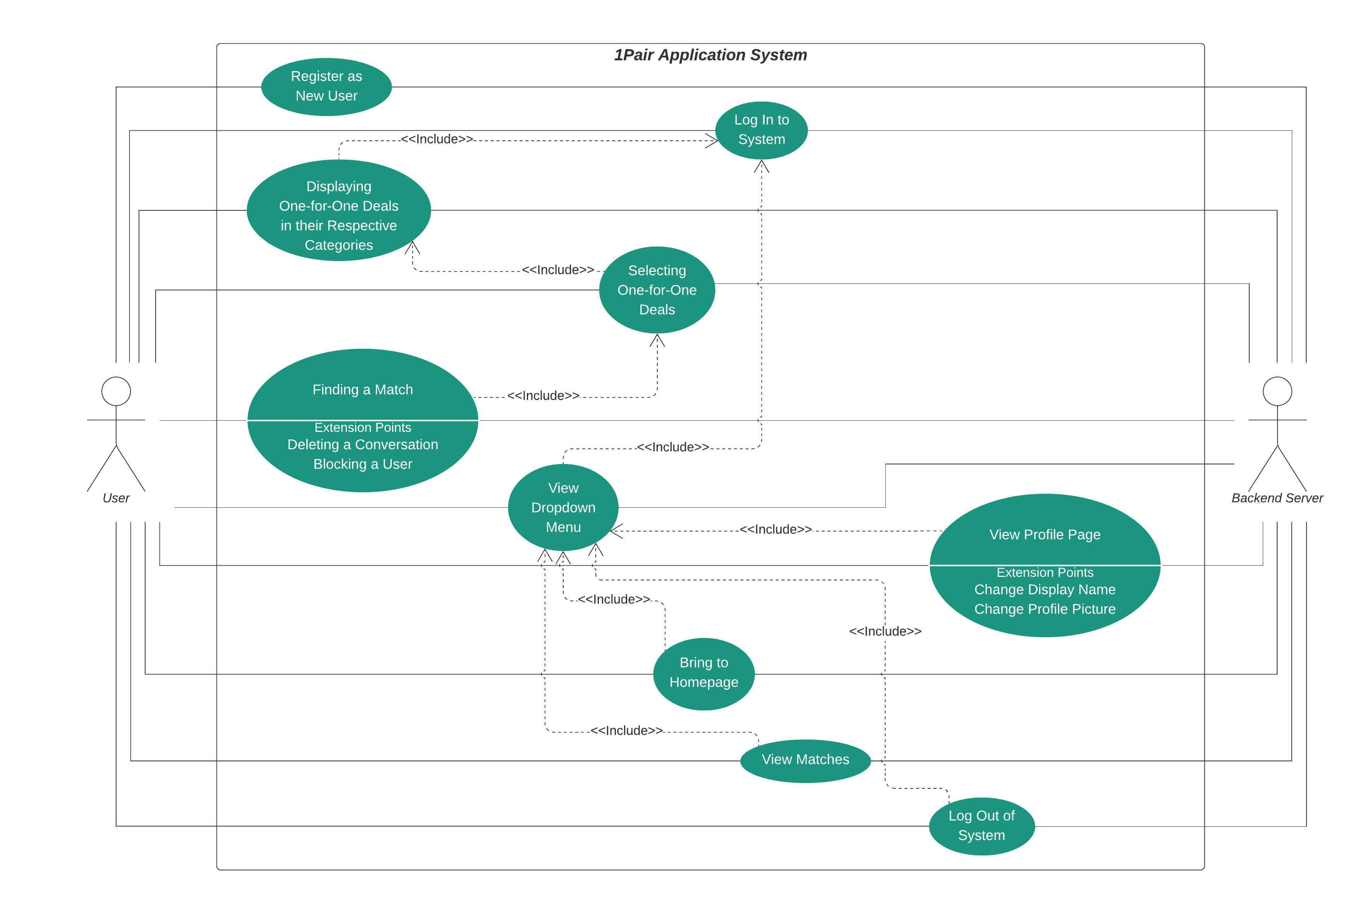
Use Case Diagram

Slide 6
Main Functions
Log In/Register
Display one-for-one deals for chosen category
Find match
Chat

Slide 7
Live Demonstration

Slide 8
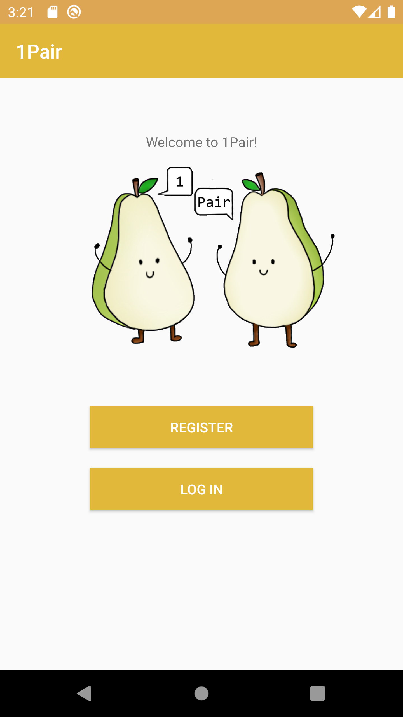
Register/Log In Screen
Place your screenshot here
Register as new user/Log in as existing user

Slide 9
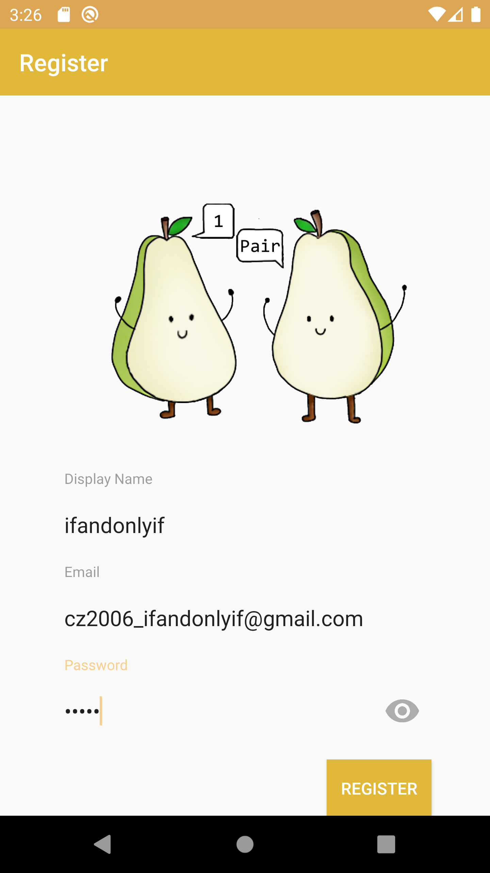

Register as new user
Fill in fields as necessary
Togglable password viewability
Place your screenshot here
Place your screenshot here

Slide 10
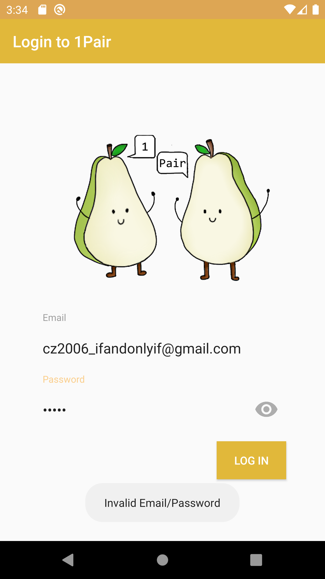
Log In as existing user
Place your screenshot here
Fill in fields as necessary
Prompt will appear if email/password is invalid

Slide 11
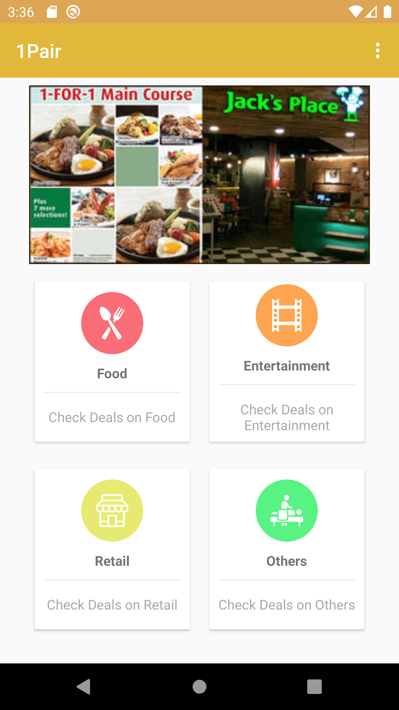
Register/Log In Screen
Place your screenshot here
Once logged in, homepage will be shown on screen
Various deals will be shown on top of screen
View deals based on categories

Slide 12
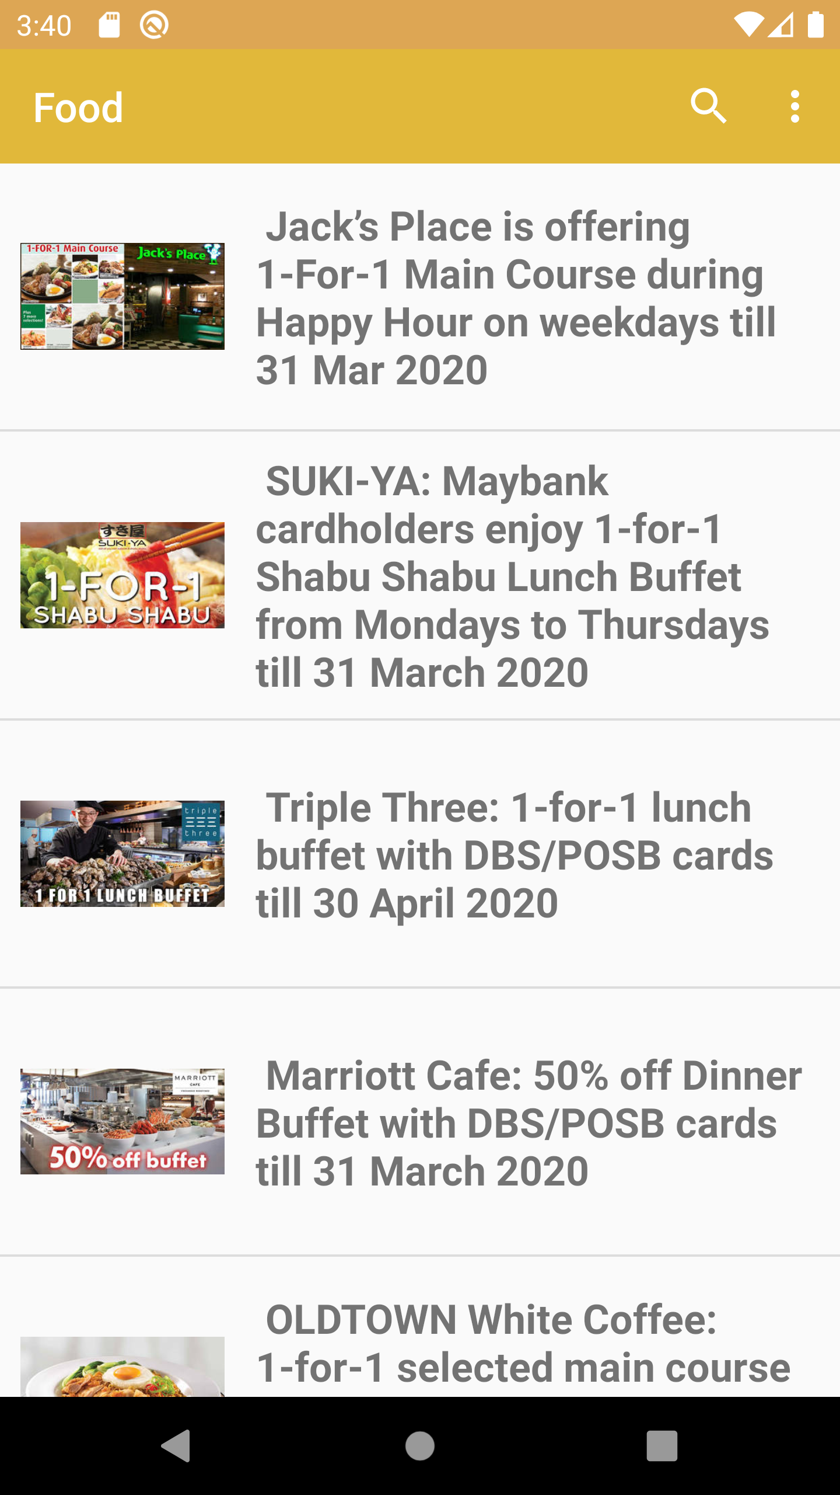
Display deals for chosen category
Place your screenshot here
All currently ongoing one-for-one deals for the selected category will be shown

Slide 13
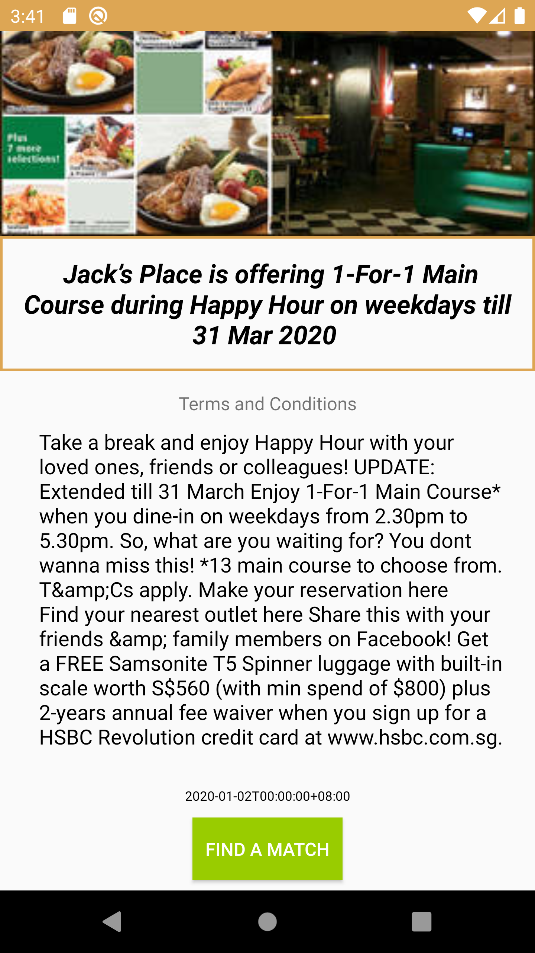
Display deals for chosen category
Place your screenshot here
Once a deal is selected, the Terms and Conditions are shown
Button to find match for given deal at the bottom

Slide 14
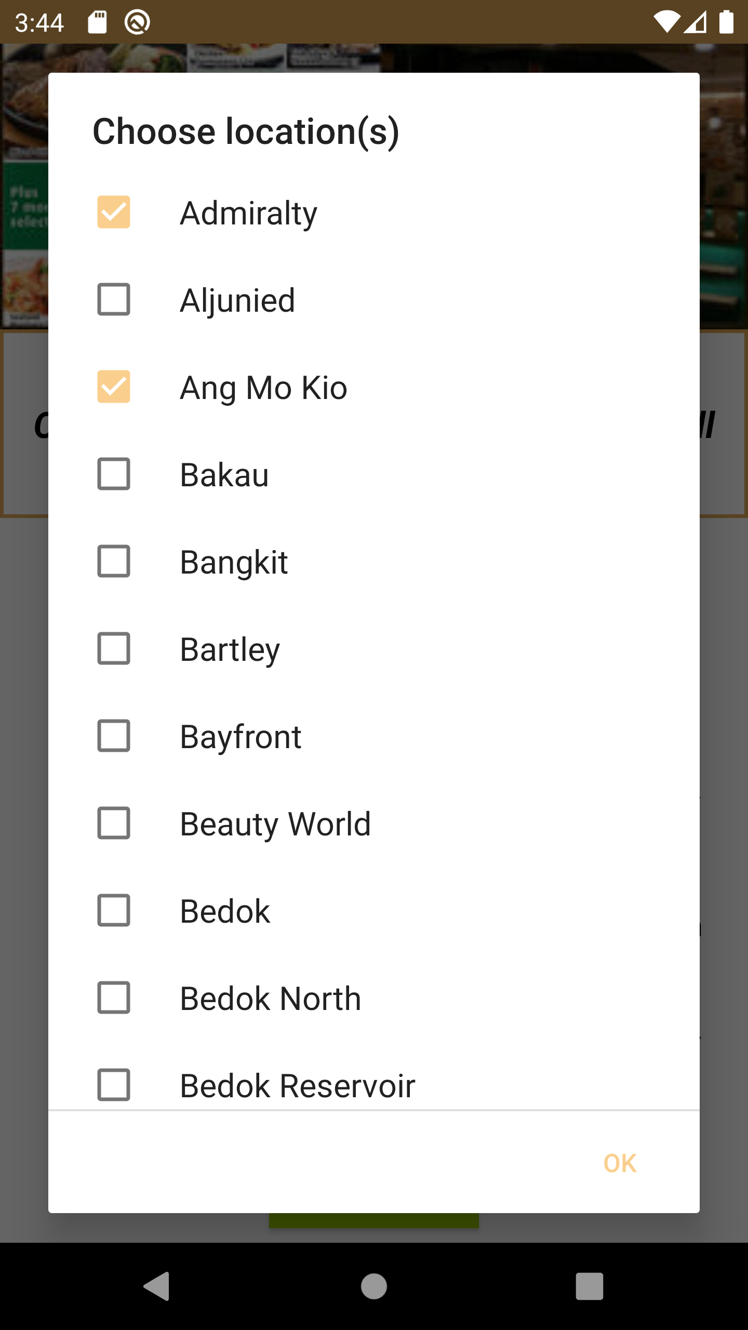
Finding a match
Place your screenshot here
User to select preferred locations for chosen deal
Multiple locations can be selected for higher chances of matching

Slide 15
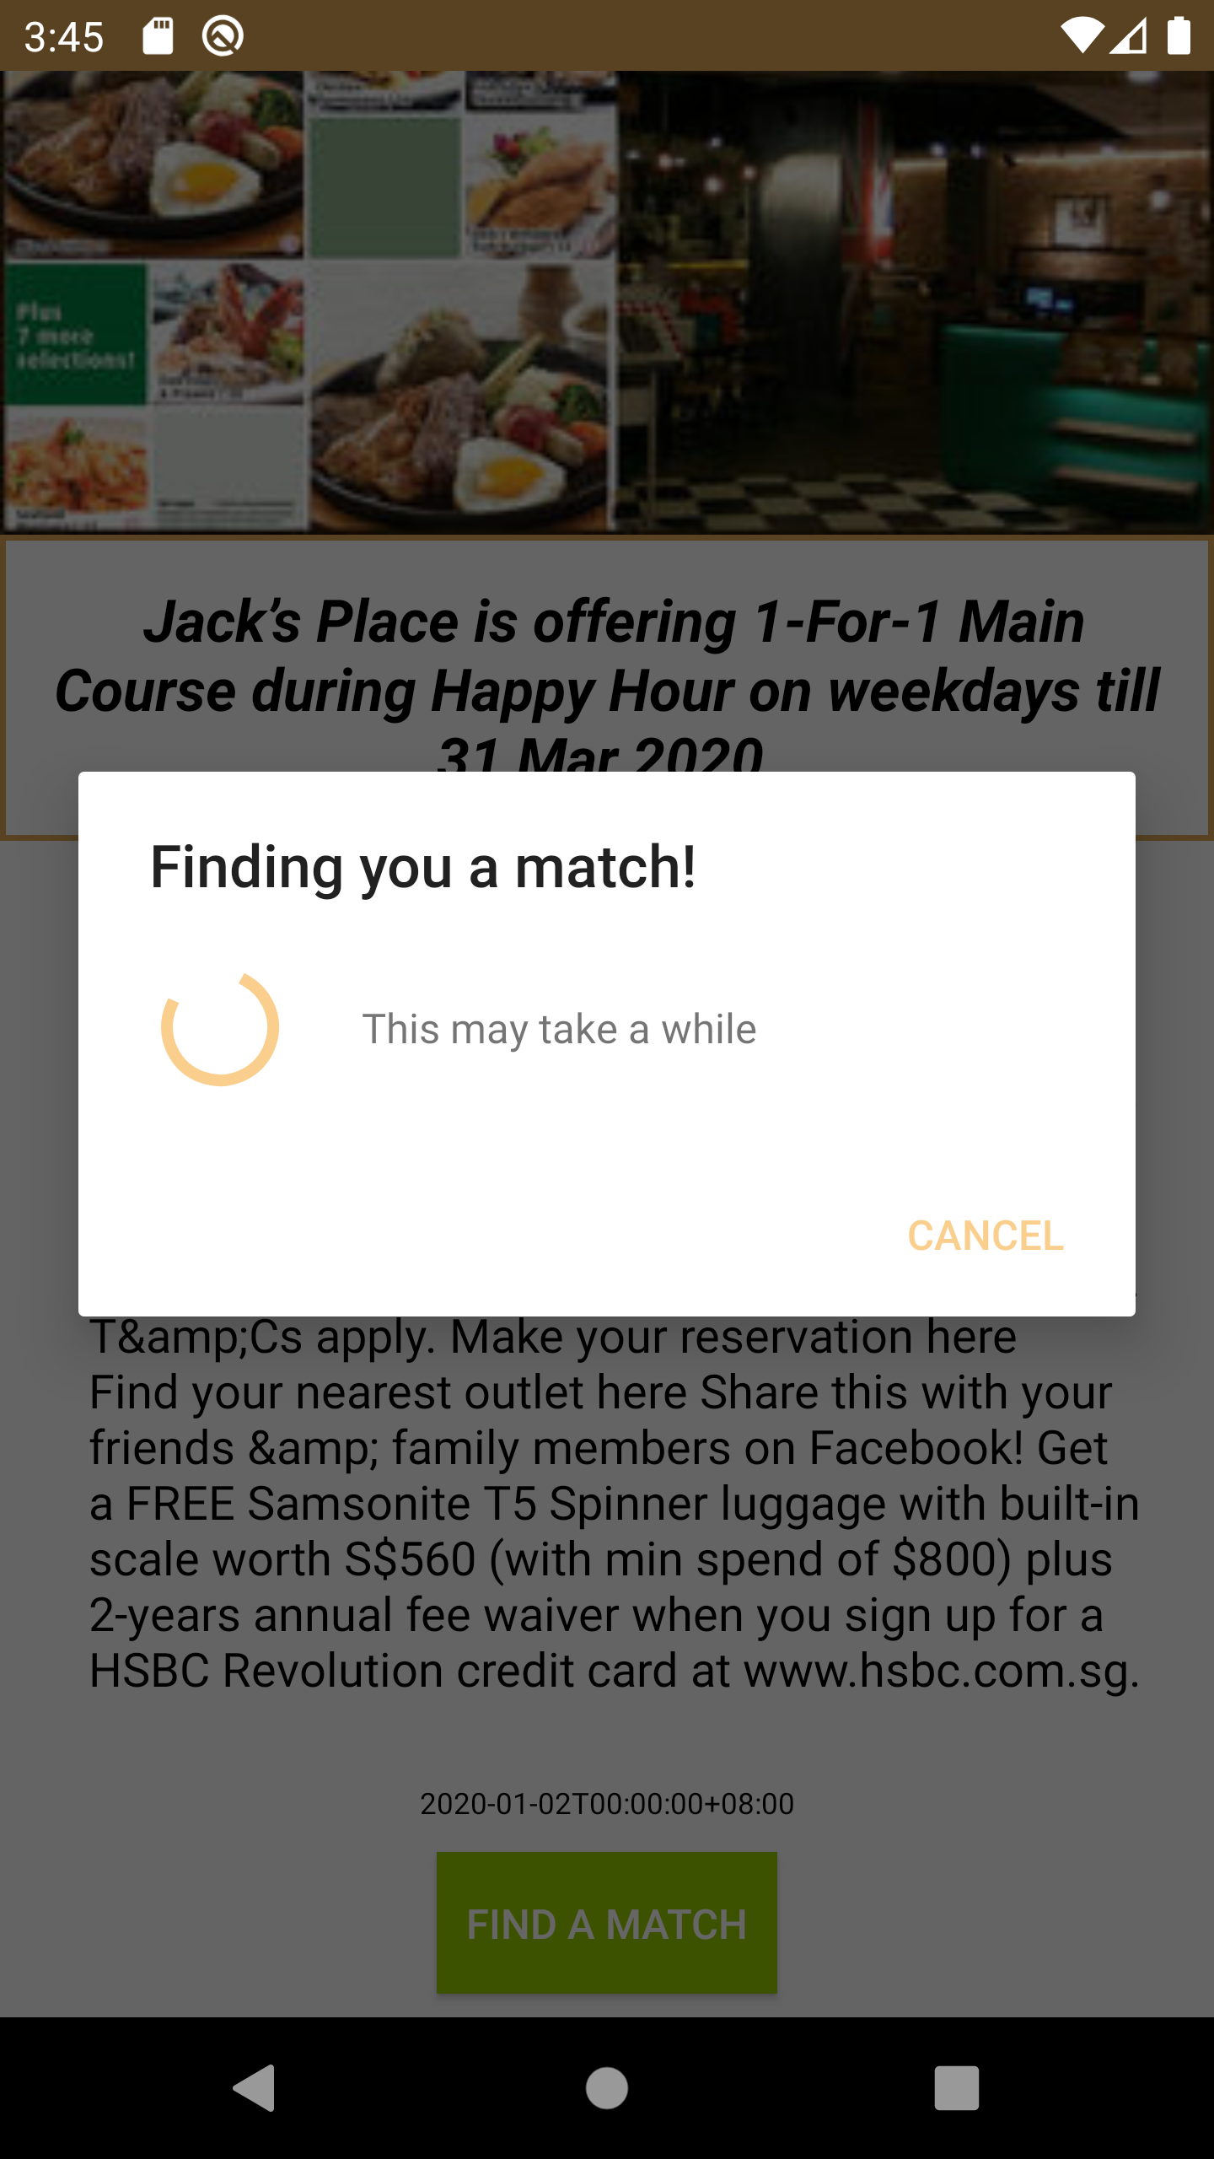
Finding a match
Place your screenshot here
Matching

Slide 16
Chat
Place your screenshot here
Chat

Slide 17
Backend

Slide 18
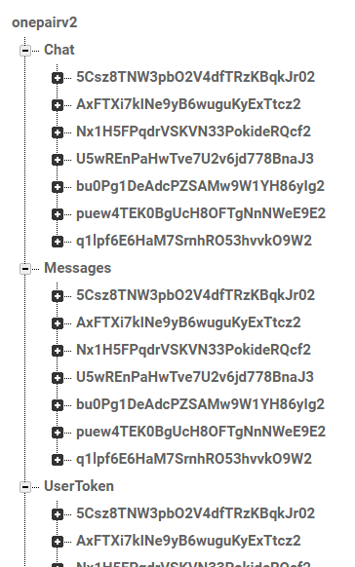
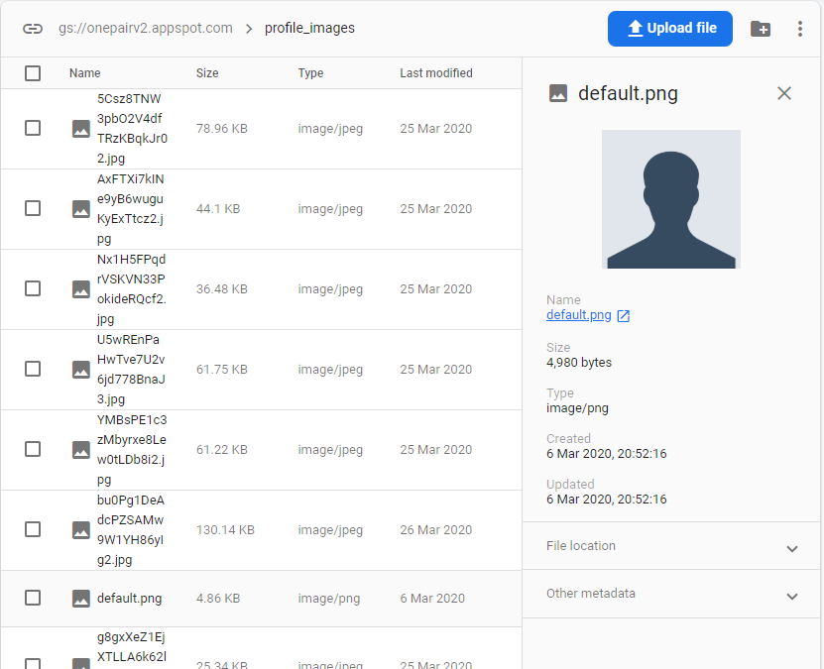
Firebase

Slide 19
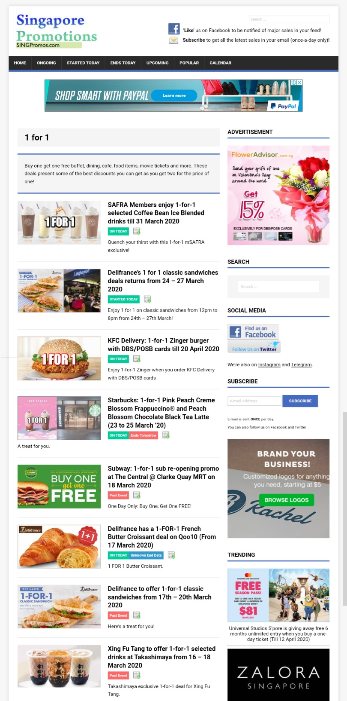
Web Scraping
https://singpromos.com/tag/1-for-1/

Slide 20
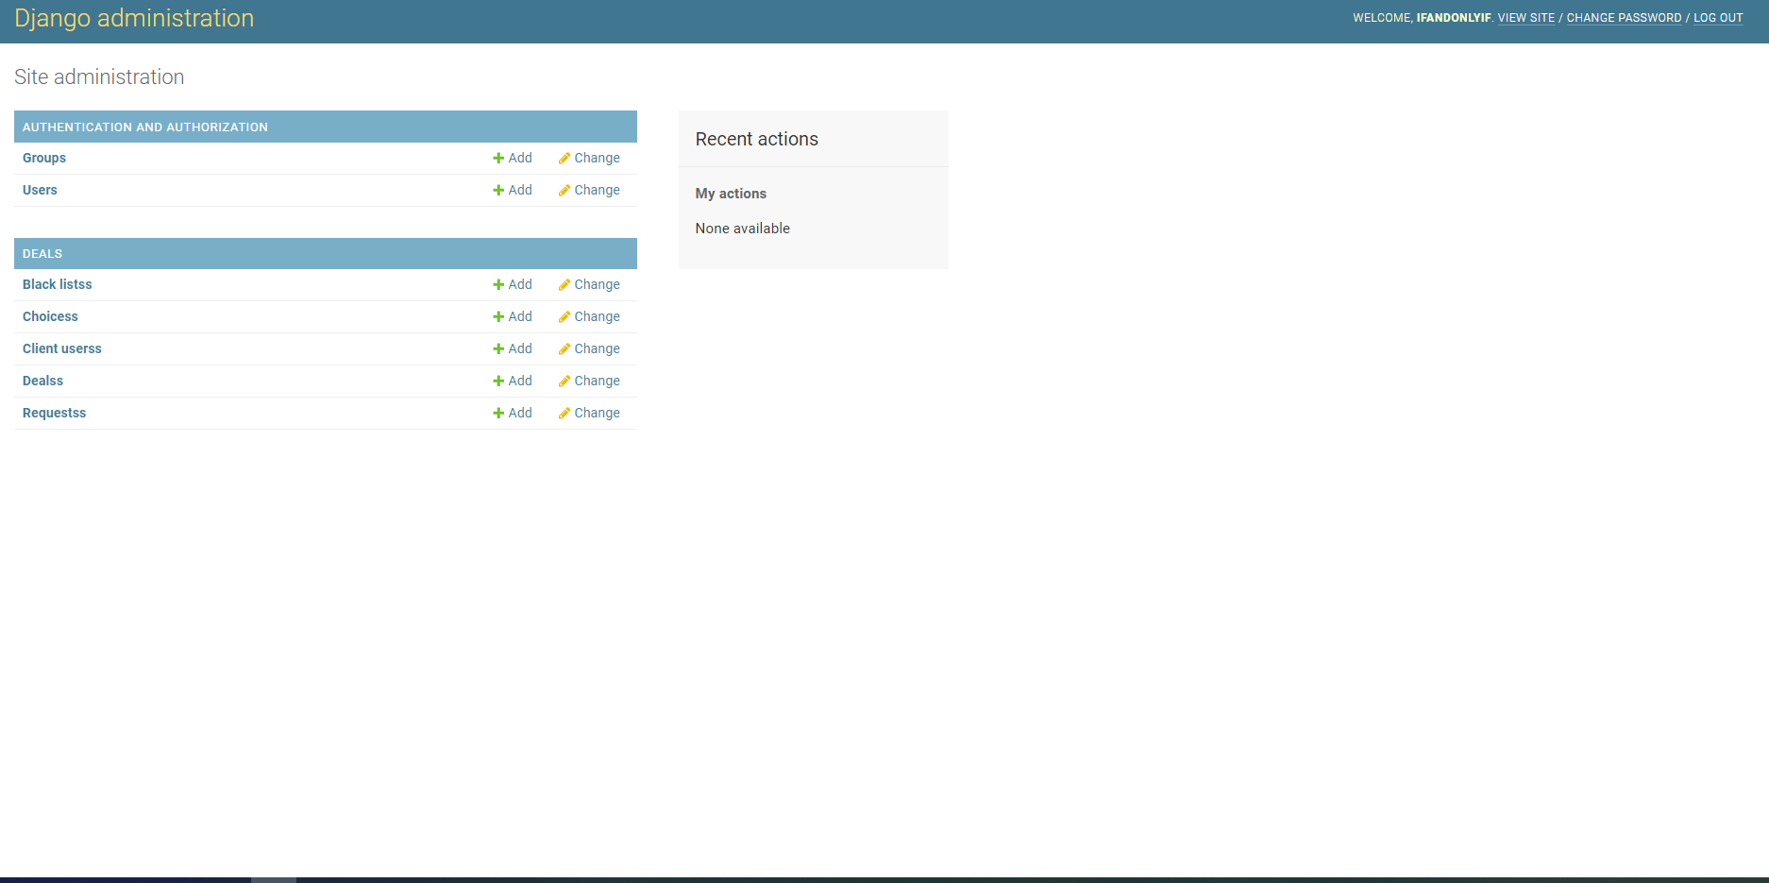
Django
Relational DataBase via SQLite
Notes:
-Django

Slide 21


RESTful API
GET
PUT
json
http
POST
Client Sends Request
Server sends response
DEL

Slide 22
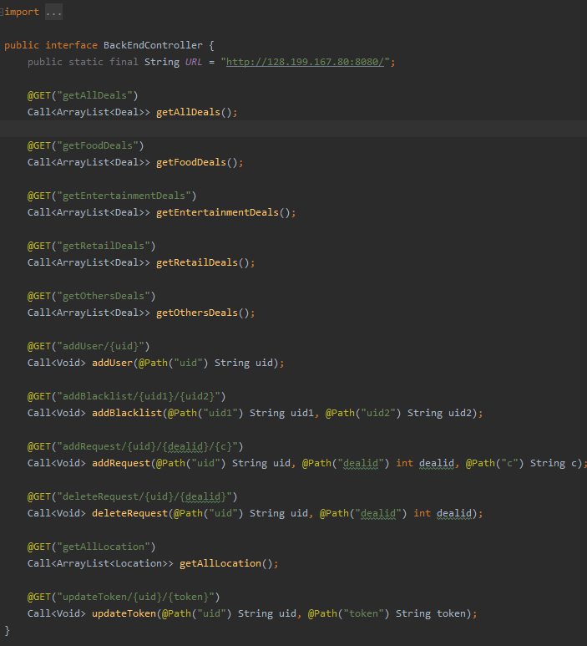
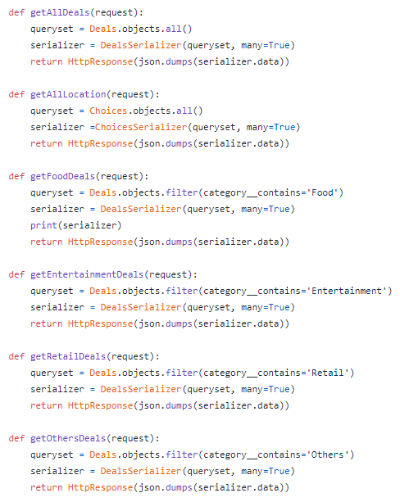
API Calls
Client Side
Server Side

Slide 23
SE Practices Applied

Slide 24
Planning
Phase 0
Phase 1
Phase 2
Phase 3
Phase 4
Brainstorm, Design Thinking Method
Setting up of Teams
Completion of Algorithm, UI and Server
Integration
Debugging & Testing
SOFTWARE
Link Front-end with Back-end i.e. Matches and Server Request, Users and Firebase, Messages and Firebase
Algorithm Team UI Team Backend Team
Function Requirement
Non-Functional Requirements
UI Mockup
Data Dictionary
Use Case Description
Use Case Model
Class diagram of entity classes
Key boundary classes and control classes
Sequence Diagrams of some Use Cases
Initial Dialog Map
Complete Use Case Description
Complete Class Diagram
Complete Dialog Map
Complete System Architecture
Complete Sequence Diagram
Slides
DOCUMENTATION

Slide 25
Project Scheduling: Critical Path Analysis Method

Slide 26
Forward Path Analysis
Phase 0 t0 = 1
Phase 2 t2 = 1
Phase 4 t4 = 1
Start t = 0
Phase 1 t1= 2
Phase 3 t3 = 1
End t = 0
Project Duration = 6
Activity | Earliest Start (ES) | Earliest Finish (EF)
Phase 0 | Start of Week 4 | End of Week 4
Phase 1 | Start of Week 5 | End of Week 6
Phase 2 | Start of Week 7 | End of Week 7
Phase 3 | Start of Week 8 | End of Week 8
Phase 4 | Start of Week 9 | End of Week 9
Notes:
Phase0: (Brain Storm) - Design Thinking Method @ around Week 4
Phase1: (Set up Team) @ around Week 5
Algo Team (Nicholas & Shahrin) - Look for Algos to implement
UI Team (Kok Liang & Grace) - Design interfaces
Backend (Jozua & Royce) - Webscrape + Set-up server
Phase2:(Completion of Algo, UI and Database) @ Week 7
Phase3: (Integration) By end of Recess Week/ Week 8
Phase4:(Debugging & Testing) : Week 9

Slide 27
Backward Path Analysis
Phase 0 t0 = 1
Phase 2 t2 = 1
Phase 4 t4 = 1
Start t = 0
Phase 1 t1= 2
Phase 3 t3 = 1
End t = 0
Project Duration = 6
Activity | Latest Start (LS) | Latest Finish (LF)
Phase 0 | Start of Week 4 | End of Week 4
Phase 1 | Start of Week 5 | End of Week 6
Phase 2 | Start of Week 7 | End of Week 7
Phase 3 | Start of Week 8 | End of Week 8
Phase 4 | Start of Week 9 | End of Week 9
Notes:
Phase0: (Brain Storm) - Design Thinking Method @ around Week 4
Phase1: (Set up Team) @ around Week 5
Algo Team (Nicholas & Shahrin) - Look for Algos to implement
UI Team (Kok Liang & Grace) - Design interfaces
Backend (Jozua & Royce) - Webscrape + Set-up server
Phase2:(Completion of Algo, UI and Database) @ Week 7
Phase3: (Integration) By end of Recess Week/ Week 8
Phase4:(Debugging & Testing) : Week 9

Slide 28
Architecture Styles

Slide 29
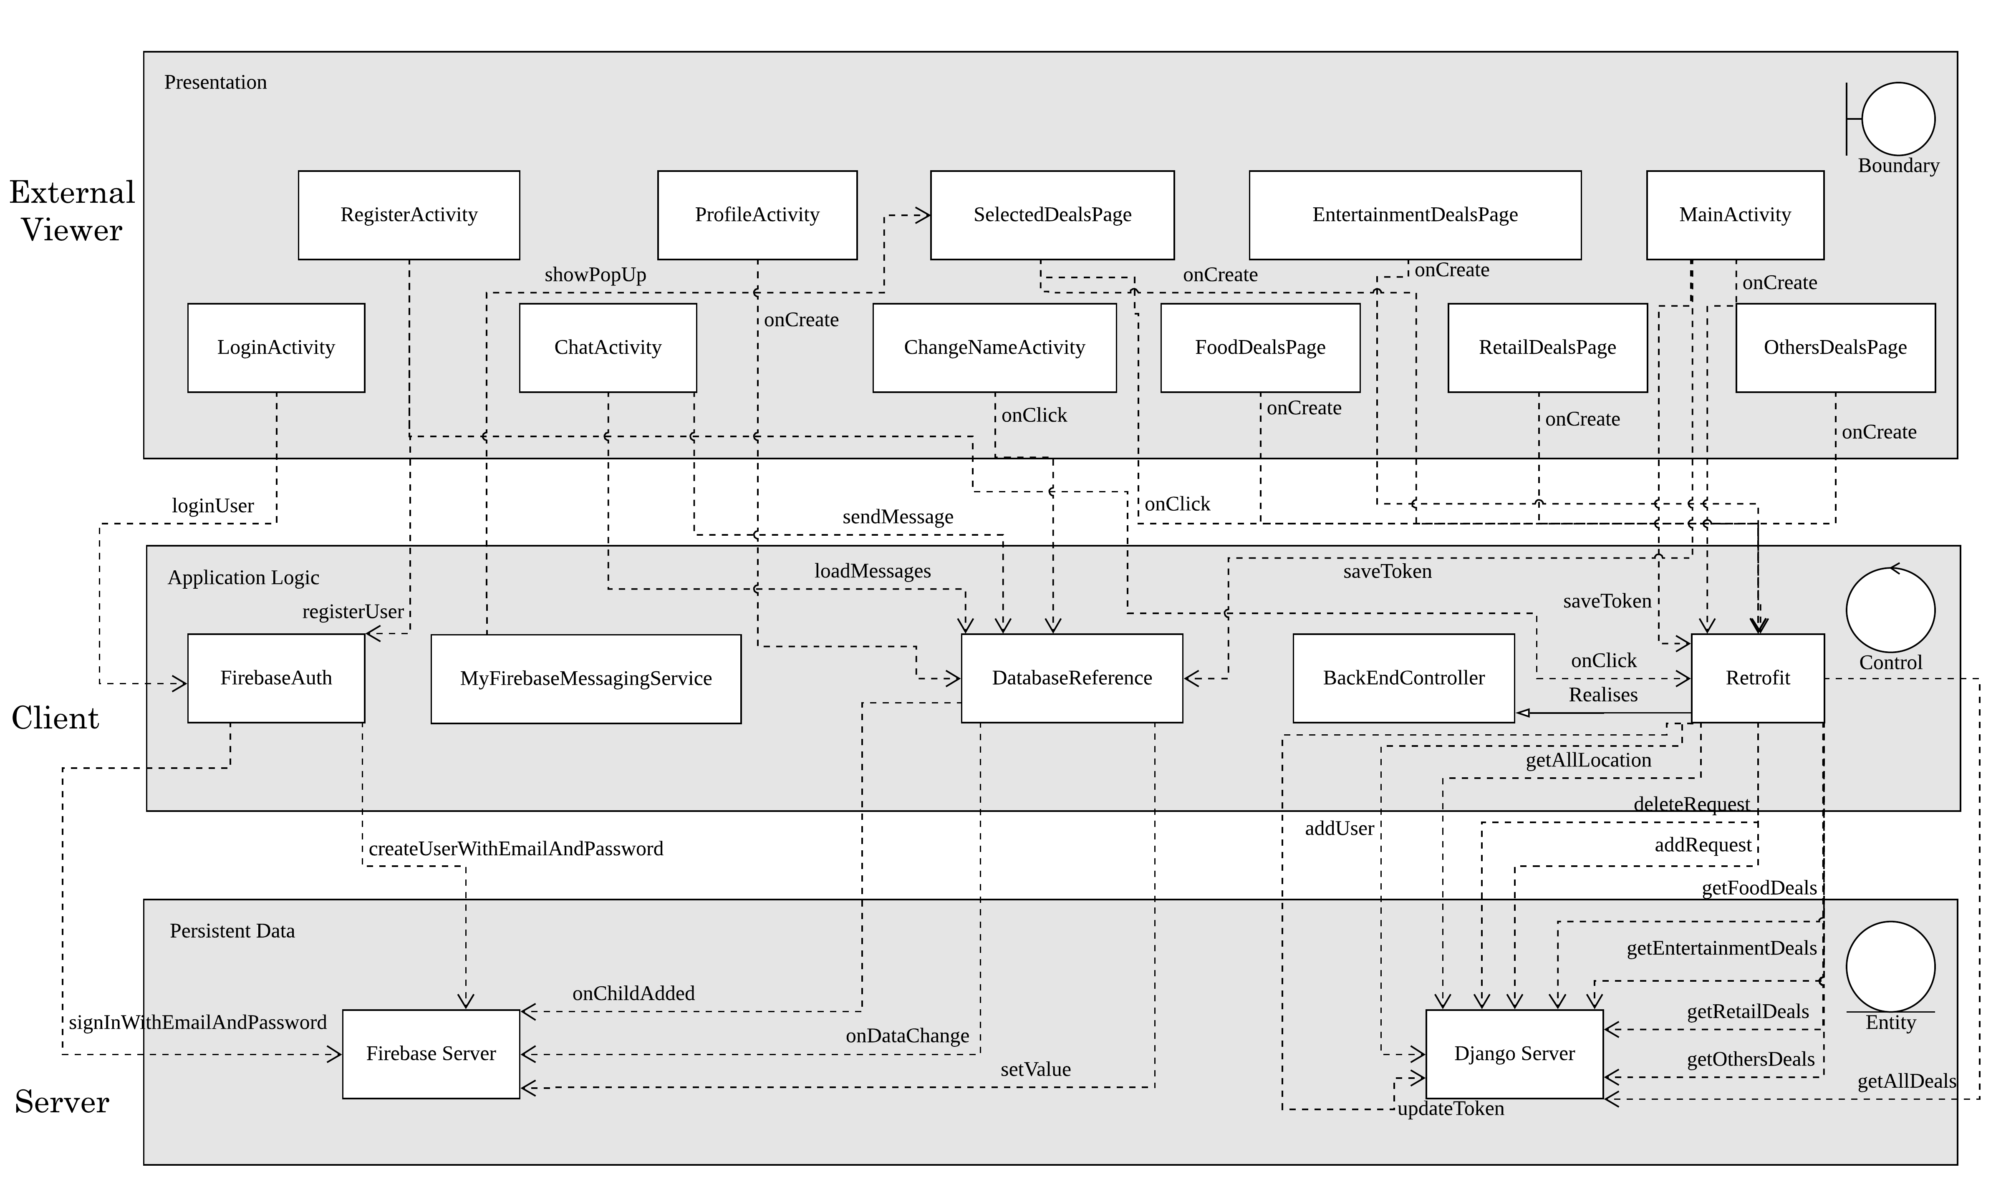
3-Tiered + Client Server Architecture Style

Slide 30
Design Issues we faced

Slide 31
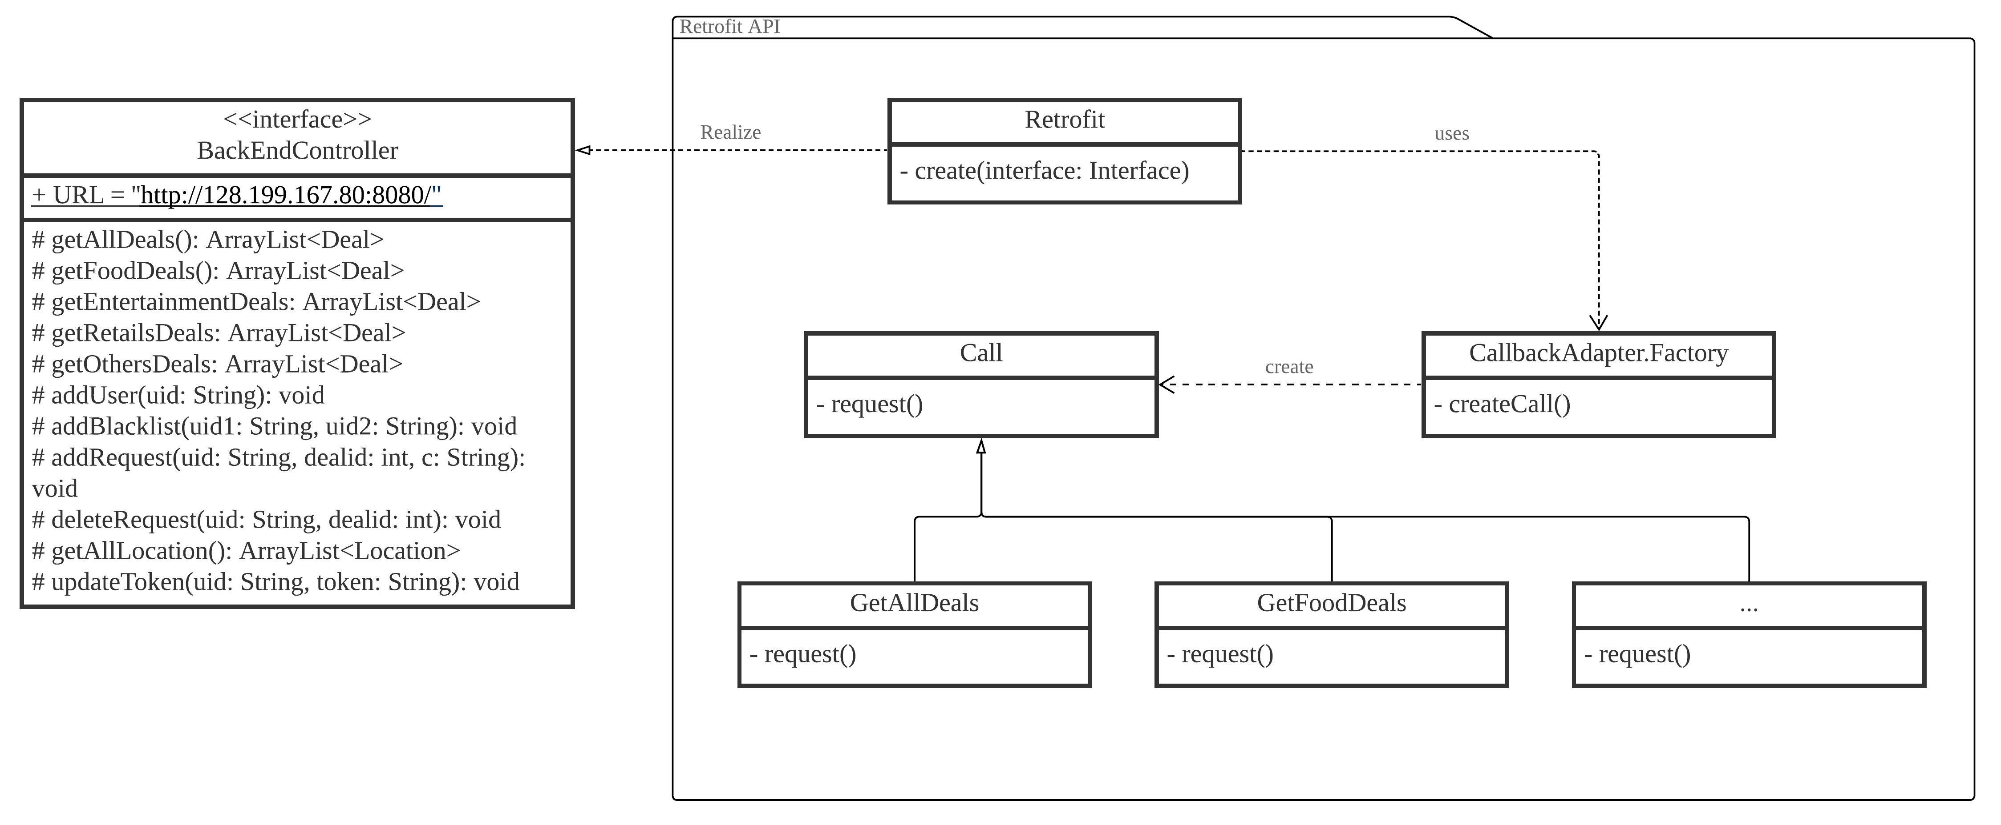
Design Issue #1
Problem:
More API calls = More changes to Code = Increase in Dependencies + Tight Coupling
Solution:
Data Access via Strategy + Factory Pattern

Slide 32
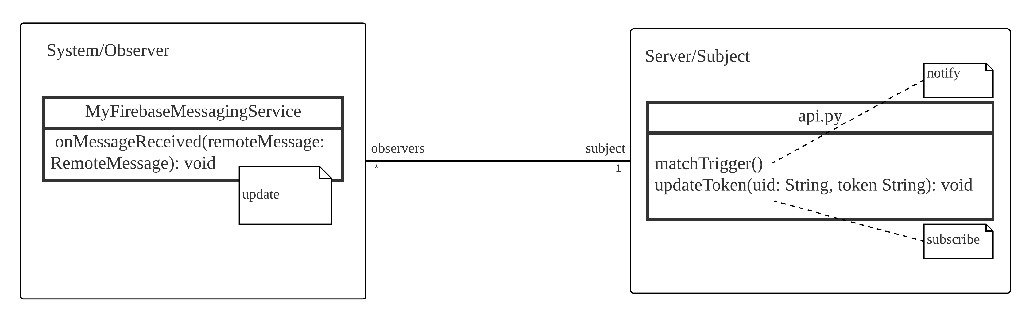
Design Issue #2
Problem:
We do not want to constantly check on the server for the result of a match.
Solution:
Observer Pattern

Slide 33
The End

Slide 34
SLACK TIME = LS –ES = 0 NO SLEEP CODE EVERYDAY EVERYNIGHT EVERYTIME EVERYWHERE☺☺☺NERDS

